Slide 1



DATA VISUALIZATION
Is it easy to understand..?
Mohamad Irwan Afandi

Slide 2

Outline
1. What is data visualization
2. Why do we need data visualization
3. The benefit of visualization
4. How do you pick the right chat
5. Keys to data storytelling
6. Data visualization tools

Slide 3


DATA VISUALIZATION
Data visualization is the graphical representation of information and data. By using visual elements like charts, graphs, and maps, data visualization tools provide an accessible way to see and understand trends, outliers, and patterns in data as quick as we can.
In the world of Big Data, data visualization tools and technologies are essential to analyze massive amounts of information and make data-driven decisions.
https://www.tableau.com/learn/articles/data-visualization

Slide 4
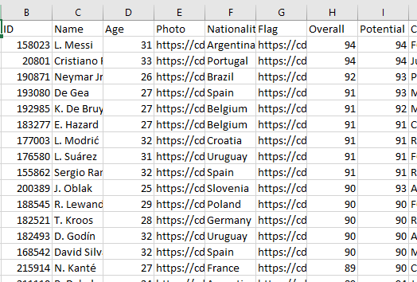
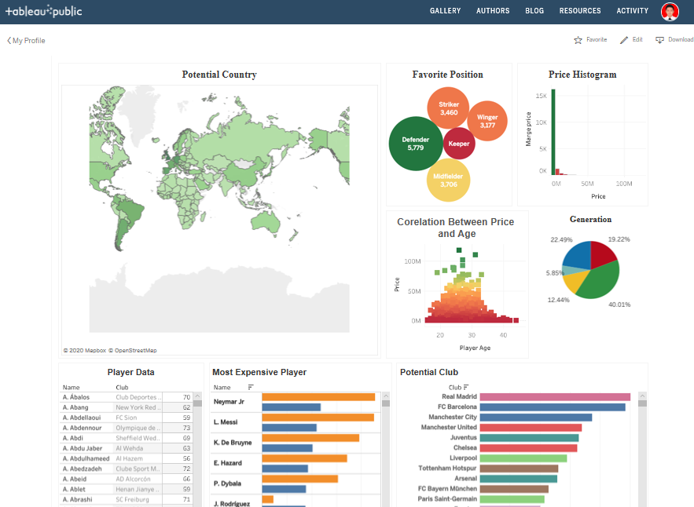
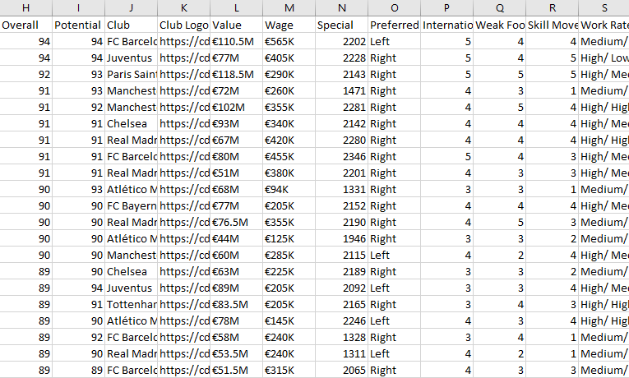
WHY DO WE NEED
DATA VISUALIZATION
Which one do you choose?
Left or right ? RIGHT
Humans are visual creatures.
Visualization will help them understand
the data as quick as they can.

Slide 5




The Benefit of
VISUALIZATION
It Makes
Better Analysis
Taking Quick Action
Understanding
the story
Grasping the
latest trends
https://www.boldbi.com/blog/data-visualization-importance-and-benefits

Slide 6
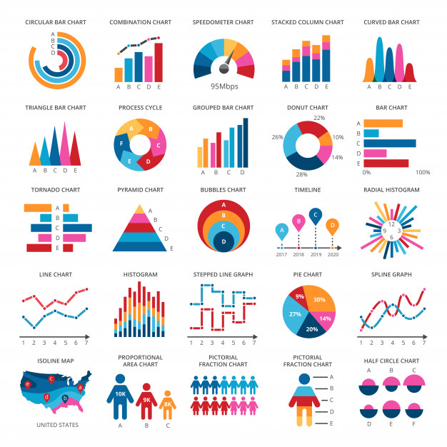
How do you
pick the right chart?
Before making a chart it's important to understand why you need one.
What is the data that you have.
Think about the message you want to share with your audience.
https://material.io/design/communication/data-visualization.html#types
https://infogram.com/page/choose-the-right-chart-data-visualization

Slide 7
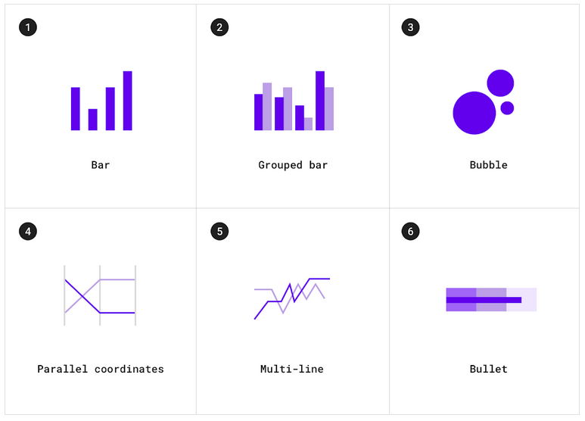
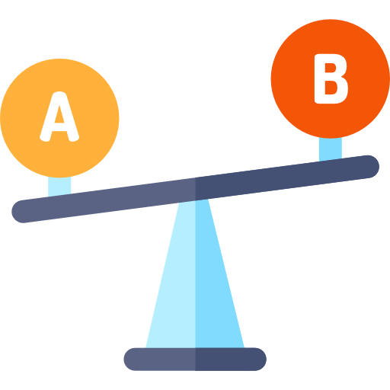
01
COMPARISON
Category comparison charts compare data between multiple distinct categories.

Slide 8

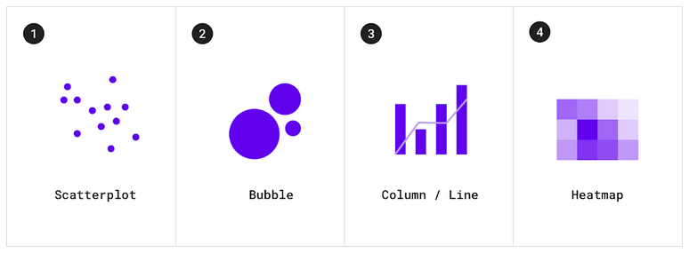
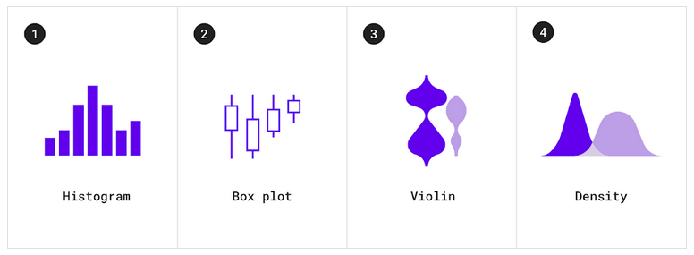

02
CORRELATION
Correlation charts show correlation between two or more variables.
Distribution charts show how often each values occur in a dataset
DISTRIBUTION
03

Slide 9
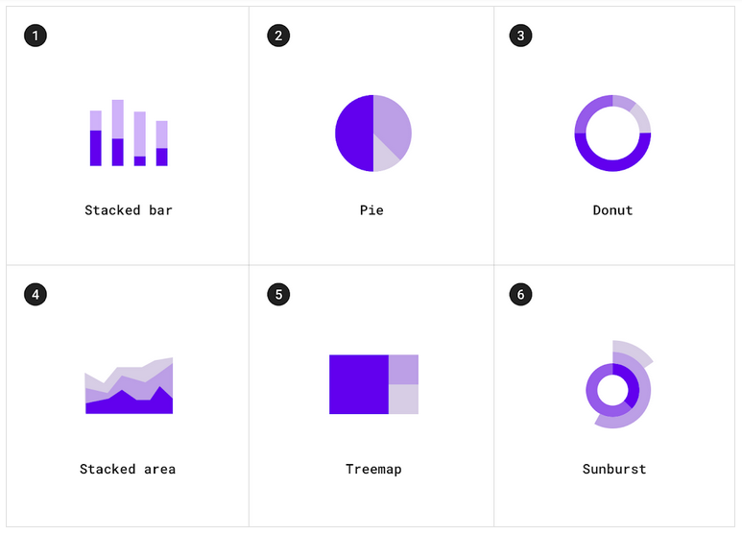

Composition charts show how partial elements add up to a total.
COMPOSITION
04

Slide 10



KEYS TO DATA STORYTELLING
by Isaac Reyes
02
Who is our audience? They will determine what data, chart, and design choice.
Use the right data.
Choose the right chart with solid grounding.
Make a story for your chart.
01
04
DATA
03
AUDIENCE
NARRATIVE
VISUALS
https://medium.com/@ODSC/isaac-reyes-on-the-key-principles-of-data-storytelling-at-odsc-east-2018-6bfcdcf581b2
It Makes
Better aAnalysis
Taking Quick Action
Understanding
the story
Grasping the
latest trends

Slide 11

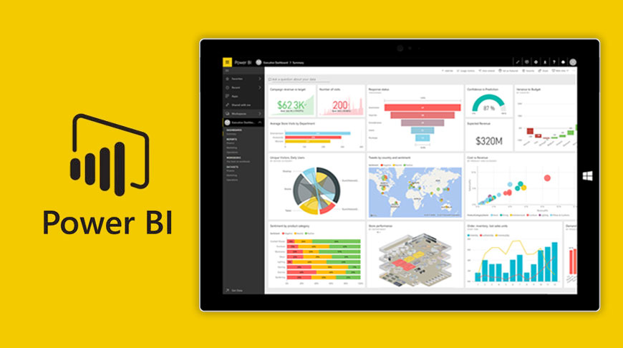

Data VISUALIZATION
TOOLS

Slide 12

Thank you …

